Slide 1
Syntax and Semantics Principles of Programming Language
S.Venkatesan
Reference: Robert W. Sebesta, Concepts of Programming Languages, 10th Edition, Pearson

Slide 2
Basics
Description of a language is very important - understandable
The study of language can be divided into
Syntax – expressions, statements and program units.
Semantics – meaning of those
Example
while(boolean_expr) statement
Syntax is as above.
Semantic is when the boolean_expr is true, the embedded statement get executed otherwise control goes after the while statement.

Slide 3
Syntax
Strings of a language are called as sentences or statements.
The syntax rules of a language specify which strings of character from the language’s alphabet are in the language.
English, for example, has a large and complex collection of rules for specifying the syntax of its sentences.
The program as strings of lexemes rather than characters.

Slide 4
Lexemes
The small units.
The description of lexemes can be given by a lexical specification.
It includes, literals, operators, and special words, etc.
Partitioned into groups – Each group will be represented by a name or token.
For example
index = 2 * count + 17
Lexemes | Tokens
Index, count | identifier
= | Equal sign
2, 17 | Int literal
+ , * | Operators

Slide 5
Syntax Analyser
Language Recognizers
is the sentence part of the language or not
Language Generators
Generate the sentences of the language.

Slide 6
Describing Syntax
Grammars (Noam Chomsky – 1956 and 1959)
Context-free – Syntax of whole programming language with minor exceptions.
Regular – the forms of tokens of programming languages can be described by regular grammars.
Backus-Naur Form (John Backus and Peter Naur)
A formal notation for specifying programming language syntax.
BNF is natural notation to describe the syntax.
Panini used similar syntax for Sanskrit that is several hundred years before Christ.

Slide 7
Grammar - Fundamentals
A metalanguage – BNF
Example
<assign> -> <var> = <expression>
It is called as production or rule
<assign> <expression> are the abstractions.
Non-terminal and Terminal

Slide 8
Derivations
Rightmost derivations
Leftmost derivations
Sentential form

Slide 9
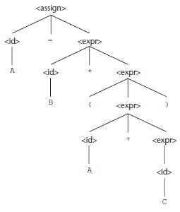
Parse Trees
Hierarchical Structure
Eg.
A = B * (A + C)

Slide 10
Problems
Ambiguity
operator precedence - order
Associativity – An expression that have the same precedence – a rule is required to specify the precedence – recursion
if then else - with matched and unmatched if
Non-Deterministic – if then else

Slide 11
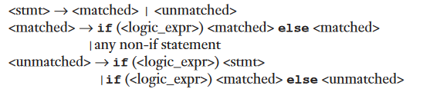
Example
if done == true
then if denom == 0
then quotient = 0
else quotient = num/denom
Grammar
I -> i E t s | i E t S e S
Deterministic
I -> i E t s S’
S’ -> e S | epsilon

Slide 12
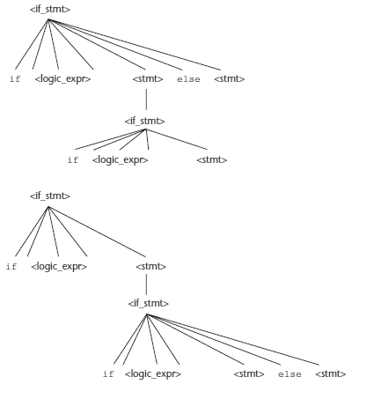
Ambiguity

Slide 13
Extended BNF
It increases its readability and writability.
Non-Deterministic
I -> i E t s | i E t S e S
Deterministic
I -> i E t s S’
S’ -> e S | epsilon
----- Simplification-----
EBNF
I -> i E t s [e S]
EBNF
<term> -> <term> (* | / | %) <factor>

